Slide 1
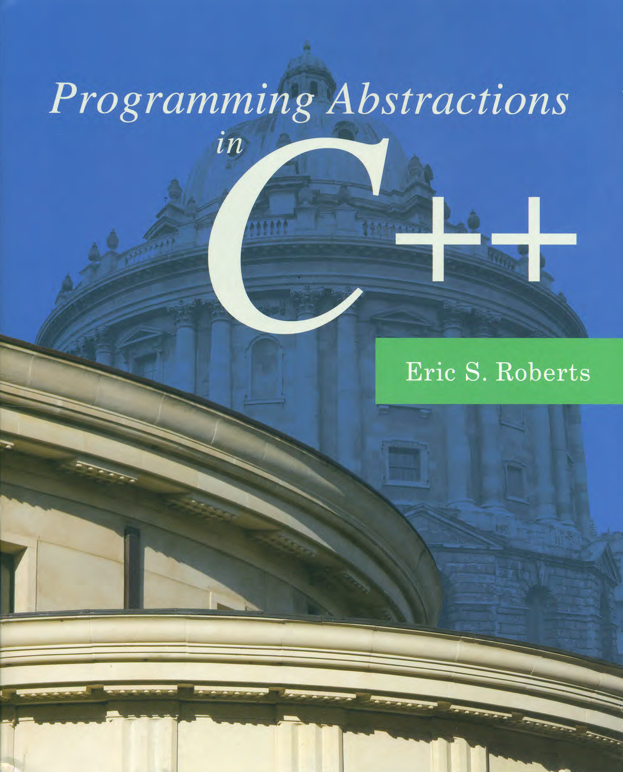
Strings
C H A P T E R 3
Whisper music on those strings.
—T. S. Eliot, The Waste Land, 1922
3.1 Using strings in C and C++
3.2 Characters and the <cctype> library
3.3 The C-style strings and the <cstring> library
3.4 Using strings as abstract values in C++
3.5 String operations
3.6 Modifying the contents of a string
3.7 Writing string applications
3.8 The Stanford strlib.h library

Slide 2
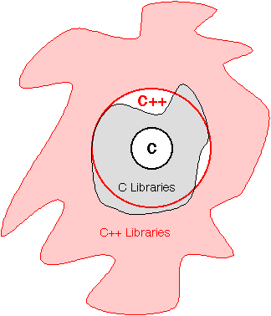
Relationship Between C and C++
One of the fundamental design principles of C++ was that it would contain C as a subset, which is also part of the reason behind the success of C++. This design strategy makes it possible to convert applications from C to C++ incrementally.
The downside of this strategy is that the design of C++ is less consistent and integrated than it might otherwise be.

Slide 3
Introduction to the C++ Libraries
A collection of classes and functions, which are written in the core language and part of the C++ ISO Standard (98/11) itself. Features of the C++ Standard Library are declared within the std namespace
Containers: vector, list, queue, stack, map, set, etc.
General: algorithm, functional, iterator, memory, etc.
Strings
Streams and Input/Output: iostream, fstream, sstream, etc.
Localization
Language support
Thread support library
Numerics library
C standard library: cmath, cctype, cstring, cstdio, cstdlib, etc.

Slide 4
Using strings in C and C++
Text data nowadays are as important as numeric data. Almost any program that you write in any modern language is likely to use string data at some point, even if it is only to display instructions to the user or to label results.
Conceptually, a string is simply a sequence of characters, which is precisely how strings are implemented in C.
As a newly designed language, especially one to extend C with the object-oriented programming paradigm, C++ supports a higher-level view of strings, as objects.
The different strategies used by C and C++ on strings show the differences between different programming paradigms.

Slide 5
Characters
Both C and C++ use ASCII (American Standard Code for Information Interchange) as their encoding for character representation. The data type char therefore fits in a single eight-bit byte.
With only 256 possible characters, ASCII is inadequate to represent the many alphabets in use throughout the world. In most modern language, ASCII has been superseded by Unicode, which permits a much larger number of characters.
Even though the weaknesses in the ASCII encoding were clear at the time C++ was designed, changing the definition of char was impossible given the decision to keep C as a subset.
The C++ libraries define the type wchar_t to represent “wide characters” that allow for a larger range. The details of the wchar_t type are beyond the scope of this text. We will stick with the traditional char type.

Slide 6
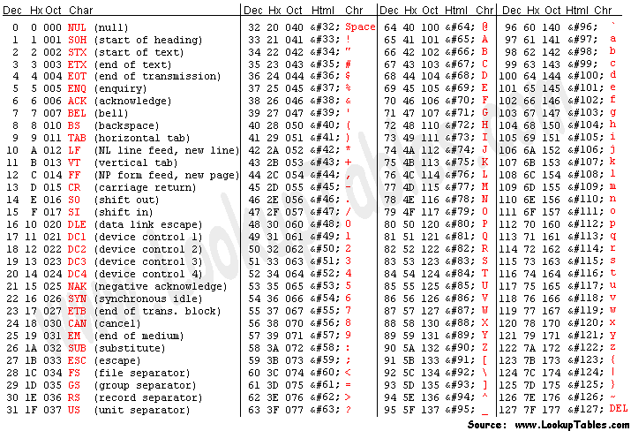

Slide 7
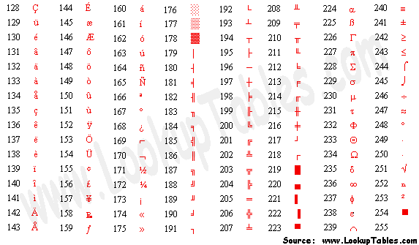

Slide 8
The <cctype> (ctype.h) Interface
bool isdigit(char ch)
Determines if the specified character is a digit.
bool isalpha(char ch)
Determines if the specified character is a letter.
bool isalnum(char ch)
Determines if the specified character is a letter or a digit.
bool islower(char ch)
Determines if the specified character is a lowercase letter.
bool isupper(char ch)
Determines if the specified character is an uppercase letter.
bool isspace(char ch)
Determines if the specified character is whitespace (spaces and tabs).
char tolower(char ch)
Converts ch to its lowercase equivalent, if any. If not, ch is returned unchanged.
char toupper(char ch)
Converts ch to its uppercase equivalent, if any. If not, ch is returned unchanged.

Slide 9
The Legacy of C-Style Strings
In C, we can represent strings, i.e., sequences of characters, as plain arrays of elements of a character type:
If you put double quotation marks around a sequence of characters, you get what is called a C string (literal), in which the characters are stored in an array of bytes, terminated by a null byte whose ASCII value is 0. E.g., the characters in the C string "hello, world" are arranged like this:
Character positions in a C string are identified by an index that begins at 0 and extends up to one less than the length of the string.
char cstr[10];
char cstr[] = "hello";
char cstr[] = { 'h', 'e', 'l', 'l', 'o', '\0' };
h
e
l
l
o
,
w
o
r
l
d
\0
0
1
2
3
4
5
6
7
8
9
10
11
12

Slide 10

Calling C String Functions
The <cstring> (string.h) interface offers a lot of functions you can use to operate C strings. For example, if you want to determine the length of a C string cstr, you can use the following function strlen:
If you want to assign a value to a C string cstr, you can use the following function strcpy:
However, you cannot assign a value to a C string except for initialization:
char cstr[] = "hello";
int len = strlen(cstr);
strcpy(cstr, "world");
cstr = "world";
cstr[] = "world";

Slide 11
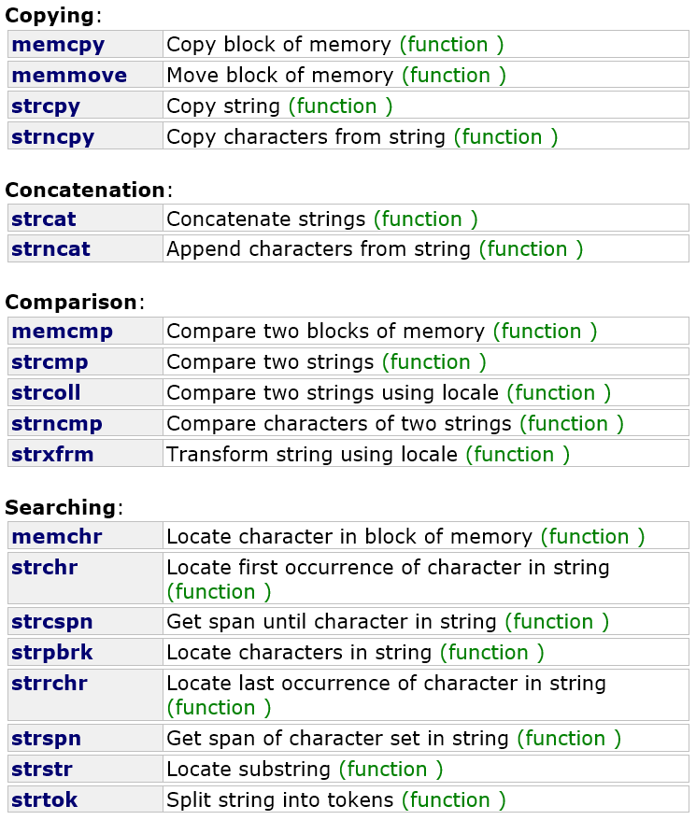
The <cstring> (string.h) Interface

Slide 12
Using Strings as Abstract Values
As a design consequence, C++ must retain the older char type and string model it inherits from its predecessor, which is achieved by including in the C++ standard library the C standard library, such as <cctype> (ctype.h); <cstring> (string.h).
As a newly designed language, especially one to extend C with the object-oriented programming paradigm, C++ supports a higher-level view of strings, as objects.
A C++ library <string> provides a convenient abstraction for working with strings of characters by making string a class whose methods hide the underlying complexity.
A class is the term for data types that support the object-oriented programming paradigm. The operations that apply to instances of a class are called methods.

Slide 13
Exercise
What are the meaning of the following statements?
#include <string>
// the C++ string library
#include <cstring>
// the C string library, used in C++
#include <string.h>
// the C string library, used in C
#include <cstring.h>
// most likely an error
#include "string.h"
// the compiler might still find the C string library
#include "cstring.h"
// error unless you defined cstring.h by yourself

Slide 14
Using Strings as Abstract Values
Ever since the very first program in the text, which displayed the message "hello, world" on the screen, you have been using strings to communicate with the user.
Up to now, you have not had any idea how C++ represents strings inside the computer or how you might manipulate the characters that make up a string.
At the same time, the fact that you don’t know those things has not compromised your ability to use strings effectively because you have been able to think of strings holistically as if they were a primitive type.
For most applications, the abstract view of strings you have held up to now is precisely the right one. On the inside, strings are surprisingly complicated objects whose details are better left hidden.

Slide 15
The Hello Name Program
cin >> name;
Notes:
Show HelloName.cpp and HelloFullName.cpp.

Slide 16
Concatenation and C Strings
As those of you who have studied Python already know, the + operator is a convenient shorthand for concatenation for the string objects, which consists of combining two strings end to end with no intervening characters.
In Python, the + operator is often used to combine items as part of a print call, as in
In C++, you achieve the same result using the << operator:
Although you might imagine otherwise, you can’t always use the + operator in this statement, depending on whether name is a C string (literal) or a C++ string object.
print("Hello, " + name + "!");
cout << "Hello, " << name << "!" << endl;
cout << "Hello, " + name + "!" << endl;
Notes:
Show HelloName.cpp and HelloFullName.cpp.

Slide 17
C string literal vs. C++ string object
C++ automatically converts a C string literal to a C++ string object whenever the compiler can determine that what you want is a C++ string object:
By contrast, C++ does not allow you to write the declaration:
The + operator cannot be applied to string literals. To get around this problem, you can explicitly convert a string literal to a string object by calling string on the literal:
string str = "hello, world";
string str = "hello" + ", " + "world";
string str = string("hello") + ", " + "world";
string str = "hello" + string(", ") + "world";
string str = "hello" + ", " + string("world");

Slide 18
Operators on the string Class
To convert the C++ string objects into C string literals, simply apply the c_str method to the C++ string.
Unlike most languages, C++ allows classes to redefine the meanings of the standard operators. As a result, several string operations, such as + for concatenation, are implemented as operators (overloading).
str[i]
Returns the i^{th} character of str. Assigning to str[i] changes that character.
s1 + s2
Returns a new string consisting of s1 concatenated with s2.
s1 = s2;
Copies the character string s2 into s1.
s1 += s2;
Appends s2 to the end of s1.
s1 == s2 (and similarly for <, <=, >, >=, and !=)
Compares to strings lexicographically.
str.c_str()
Returns a C-style character array containing the same characters as str.

Slide 19
Calling String Methods
Because string is a class, it is best to think of its methods in terms of sending a message to a particular object. The object to which a message is sent is called the receiver, and the general syntax for sending a message looks like this:
For example, if you want to determine the length of a string str, you might be tempted to use the following assignment statement (as in, e.g., C.)
The object-oriented version of the statement that sets len to the length of the string object str is therefore
Python does have both: len(str) or str.__len__().
receiver.name(arguments);
int len = strlen(str);
int len = str.length();

Slide 20
Common Methods in the string Class
str.length()
Returns the number of characters in the string str.
str.at(index)
Returns the character at position index; most clients use str[index] instead.
str.substr(pos, len)
Returns the substring of str starting at pos and continuing for len characters.
str.find(ch, pos)
Returns the first index ≥ pos containing ch, or string::npos if not found.
str.find(text, pos)
Similar to the previous method, but with a string instead of a character.

Slide 21
Programming Paradigms
A programming paradigm is a style or “way” of programming.
One of the characteristics of a programming language is its support for particular paradigms. Some languages make it easy to write in some paradigms but not others.
A language purposely designed to allow programming in many paradigms is called a multi-paradigm programming language, e.g., C++, Python. You can write programs or libraries that are largely procedural, object-oriented, or functional (i.e., some typical paradigms) in these languages.
In a large program, even different sections can be written in different paradigms.
C++ supports the procedural and object-oriented paradigms naturally, supports the functional paradigm through the <functional> interface, and supports many other paradigms through various external libraries.

Slide 22
Programming Paradigms
Imperative: An explicit sequence of statements that change a program's state, specifying how to achieve the result.
Structured: Programs have clean, goto-free, nested control structures.
Procedural: Imperative programming with procedures operating on data.
Object-Oriented: Computation is effected by sending messages to objects; objects have states and behavior.
Class-based: Objects get their states and behavior based on membership in a class.
Prototype-based: Objects get their behavior from a prototype object.
Declarative: Programs state the logic of a computation (what is the result you want), but not its control flow (how to get it).
Functional: Computation proceeds by (nested) function calls that avoid any global state.
Logic: Programmer specifies a set of facts and rules, and an engine infers the answers to questions.
Notes:
Show ooexample.cpp here!

Slide 23
Strings as an Abstract Data Type
Because C++ includes everything in its predecessor language, C strings are a part of C++, and you will occasionally have to recognize that this style of string exists.
For almost every program you write, it will be far easier to use the C++’s string class, which implements strings as an abstract data type, which is defined by its behavior rather than its representation. All programs that use the string class must include the <string> library interface.
The methods C++ provides for working with strings are often subtly different from those in Python’s String type. Most of these differences fall into the accidental category. The only essential difference in these models is that C++ allows clients to change the individual characters contained in a string. By contrast, Python strings are immutable, which means that they never change once they are allocated.

Slide 24
Selecting characters in strings
The <string> library offers two different mechanisms for selecting individual characters from a string:
The only difference is that at checks to make sure the index is in range, 0~str.length()-1.
Both methods can be used to assign a new value to the character:
The former has better readability while the latter has range-checking.
str[index]
str.at(index)
str[index] = 'H';
str.at(index) = 'H';

Slide 25
Iterating through the characters in strings
When you work with strings, one of the most important patterns involves iterating through the characters in a string, which requires the following code:
The following function reverses the argument string so that, calling reverse("desserts") returns "stressed":
for (int i = 0; i < str.length(); i++) {
. . . body of loop that manipulates str[i] . . .
}
for (int i = str.length() - 1; i >= 0; i--)
string reverse(string str) {
string rev = "";
for (int i = str.length() - 1; i >= 0; i--) {
rev += str[i];
}
return rev;
}

Slide 26
Modifying the Contents of a String
In many languages, including Python, Java, C#, strings are immutable, which means that they never change once they are allocated.
C++, by contrast, allows clients to change the contents of a string, both by assigning new values to selected characters and by calling string methods such as the following:
str.erase(pos, count)
Destructively changes str
Deletes count characters from str starting at position pos.
str.insert(pos, text)
Destructively changes str
Inserts the characters from text into str starting at position pos.
Destructively changes str
str.replace(pos, count, text)
Replaces count characters in str with text starting at position pos.

Slide 27
Modifying the Contents of a String
As a tool for writing programs that are easier to debug and maintain, immutable strings have many advantages over their modifiable counterparts in C++. Fortunately, it is easy to secure these advantages in C++ by avoiding the use of destructive operations like erase, insert, replace, and assignment to individual characters.
Example: Case conversion without changing the original (safe)
string toUpperCase(string str) {
string result = "";
for (int i = 0; i < str.length(); i++) {
result += toupper(str[i]);
}
return result;
}

Slide 28
Avoiding the use of destructive operations
Example: Case conversion in place (efficient)
Example: Case conversion both efficiently and safely
void toUpperCaseInPlace(string & str) {
for (int i = 0; i < str.length(); i++) {
str[i] = toupper(str[i]);
}
}
string toUpperCase(string str) {
toUpperCaseInPlace(str);
return str;
}

Slide 29

Exercise: Writing String Applications
An acronym is a word formed by taking the first letter of each word in a sequence, as in
Write a C++ program that generates acronyms, as illustrated by the following sample run:
More examples:
Recognizing Palindromes
Translating English to Pig Latin
"self-contained underwater breathing apparatus"
"scuba"
Acronym
Program to generate acronyms
Enter string:
not in my back yard
The acronym is "nimby"
Enter string:
Federal Emergency Management Agency
The acronym is "FEMA"
Enter string:
Notes:
Show Acronym.cpp

Slide 30
The Stanford strlib.h Interface
integerToString(n)
Converts n to a C++ string.
stringToInteger(str)
Converts the digits in str to an integer.
realToString(d)
Converts d to a C++ string.
stringToReal(str)
Converts the digits in str to floating point.
toUpperCase(x)
Converts str to upper case.
toLowerCase(x)
Converts str to lower case.
equalsIgnoreCase(s₁, s₂)
Compares s₁ and s₂ without regard to case.
startsWith(str, prefix)
Returns true if str starts with prefix.
endsWith(str, suffix)
Returns true if str ends with suffix.
trim(str)
Returns a string removing spaces from the ends.

Slide 31
The End

